Slide 1
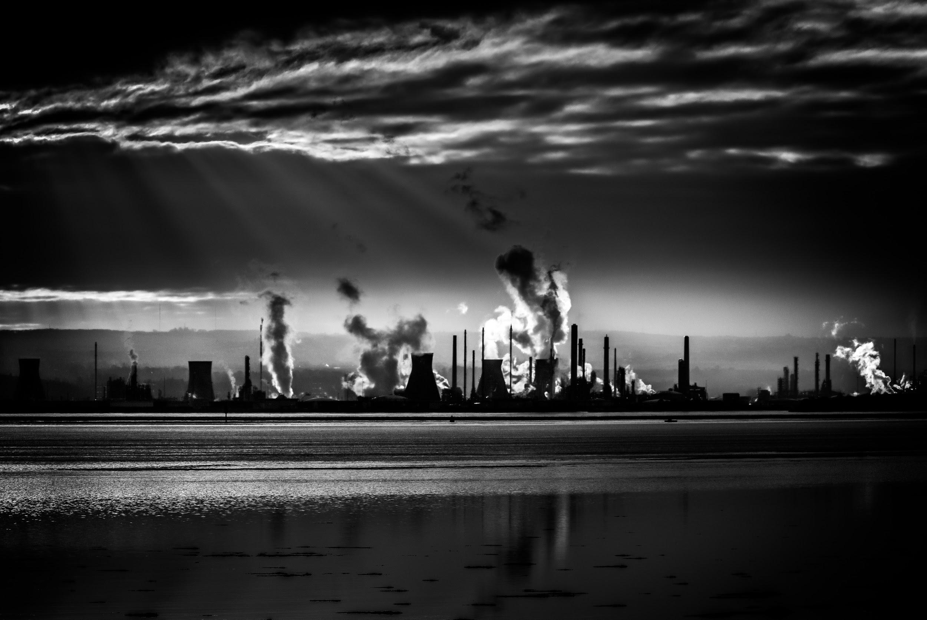
Is your Environment
Hurting your Health?
By Hotspotters
Notes:
Is your environment hurting your health?
While many of us have the privilege of living in a clean, healthy home and neighborhood, people of low socioeconomic status often live in environments that lead to them ending up in the ED.

Slide 2

4,732,161
People in Boston
130,000
Emergency department visits in BMC
Notes:
Of the 4.7 million people in the greater Boston area, 130 thousand people each year end up in the ED of BMC alone, costing our medical system millions of dollars.

Slide 3
Prevention is the
Best Medicine
Notes:
We believe that “prevention is the best medicine” and that we can reduce ED visits by addressing environmental determinants of health through data-driven interventions.

Slide 4
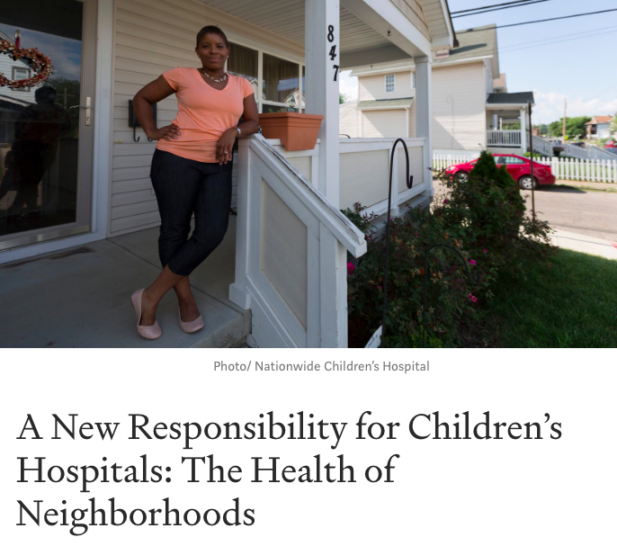
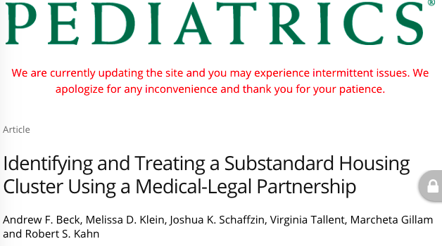
Notes:
We were inspired by a story from Cincinnati Children’s hospital, where one doctor noticed that there were multiple children coming in with asthma who had families complaining about the lack of air conditioning in their apartments. This doctor mapped out the locations of these children’s homes and found that one landlord had been causing all of these problems, and through their innovative medical-legal partnership, they successfully sued the landlord to bring their homes up to code.

Slide 5
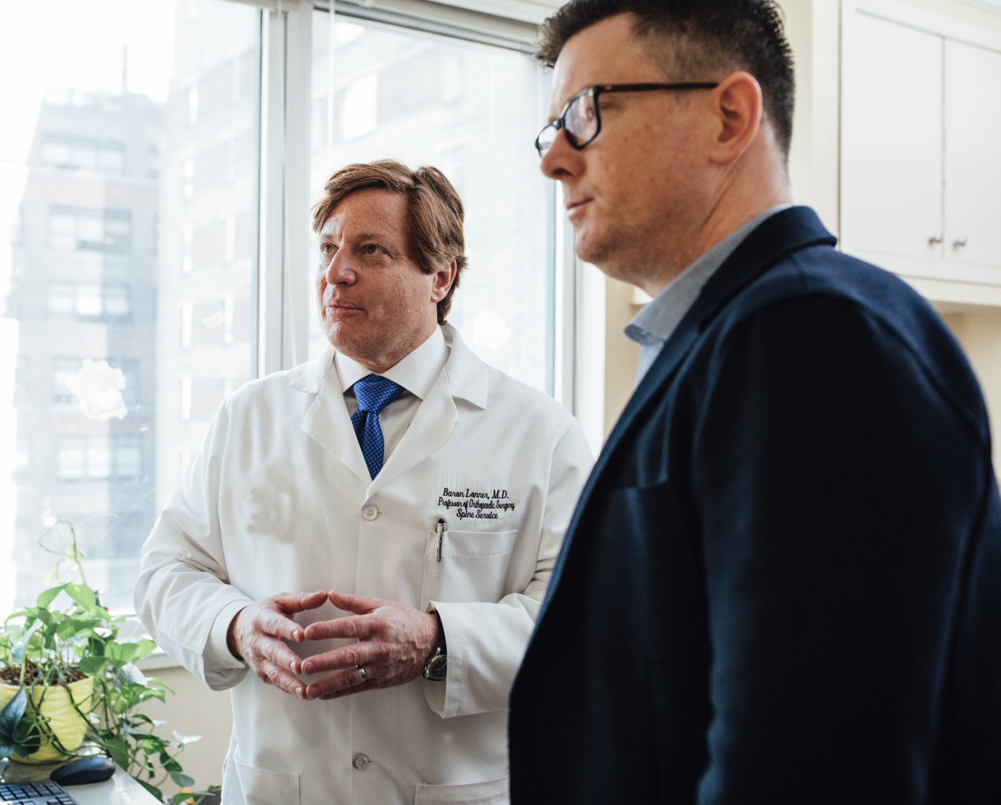
Partnerships
Boston Medical
Medical - Legal
Improve the health and well-being of vulnerable populations
Notes:
BMC also has a medical-legal partnership which “allies healthcare providers with lawyers to improve the health and well-being of vulnerable populations.” However, it is still challenging for emergency doctors overwhelmed with patients to identify hotspots of disease which may have intervenable environmental causes.

Slide 6
Environmental Determinants of Health
Housing Air Quality
Poor quality of air leads to premature death, cancer, cardiovascular and respiratory problems.
Asthma | COPD Exacerbations
Dangerous Intersections
People are exposed to different environments and communities within their travel.
Bike-Car Accidents, Motor Vehicle Accidents
Local Polluters
Effects of lead, arsenic, and other poisoning from natural and manmade materials.
Toxic Ingestions
Local Disease Outbreaks
School, Apartment, and Nursing Home Disease Outbreaks
E.Coli, Legionella, Community Acquired Pneumonia
Notes:
In addition to Apartment Mold, Dangerous Intersections, Local Polluters, and School, Apartment, and Nursing Home Disease Outbreaks all lead to health problems like Asthma, car and bike accidents, and community-acquired illnesses that bring many people to the ED
Growing population
Trends and Health
Lack of resources - allocation of resources
Risk of serious illness -
Poverty Expensive Healthcare
Outdoor air quality
Surface and ground water quality
Toxic substances and hazardous wastes
Homes and communities
Infrastructure and surveillance
Global environmental health

Slide 7

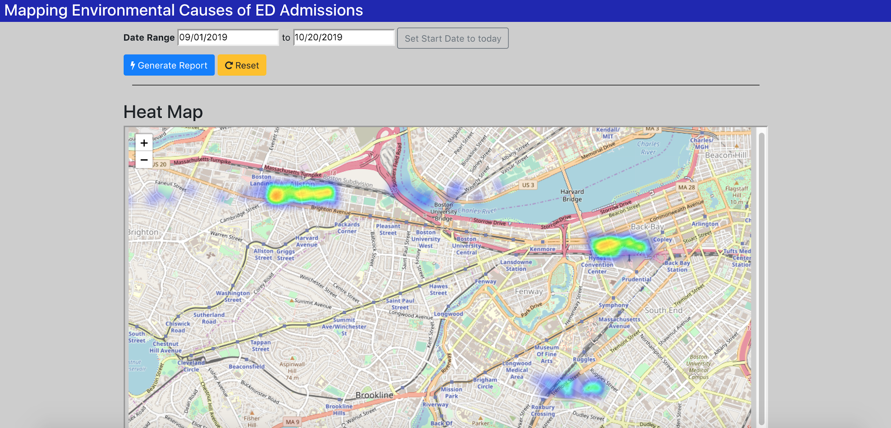
Solution
Hotspotter: A Unified Database of Environmental Causes of Emergency Department Admissions
Goal:
Identify disease hotspots in the community which can be acted on by:
BMC’s Medical Legal Partnership
Public Health Officials
Notes:
Our solution is a unified database that identifies disease hotspots in the community which can be acted on by BMC’s existing medical legal partnerships and community outreach programs as well as public health officials.

Slide 8
Solution
Data Gathering
Analysis
Data-Driven Interventions
BMC’s Medical Legal Partnership
Public Health Officials
City Officials
Nonprofit Advocacy Groups
Patients
EHRs
Notes:
Our solution will accept data from simple patient surveys and EHR integration to capture locations of specific categories of disease which may be due to environmental causes.
Data will come from multiple sources and be shared with multiple parties to work together to identify and address the environmental determinants of health.

Slide 9
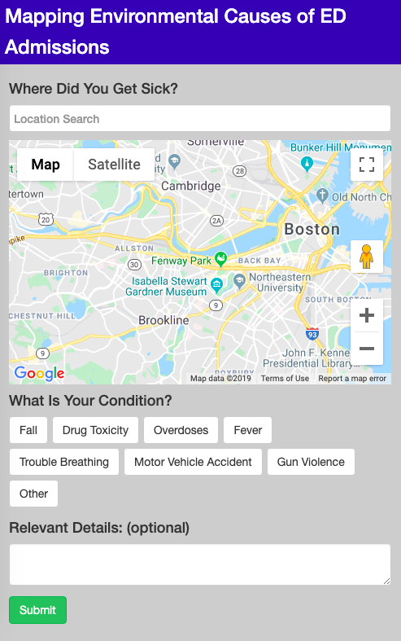
Try it out at hotspotter.herokuapp.com
Notes:
This data can be visualized through an interactive dashboard that shows real-time neighborhood clustered hotspots of disease trends as well as vectors of disease movement that may be due to changing environments.

Slide 10
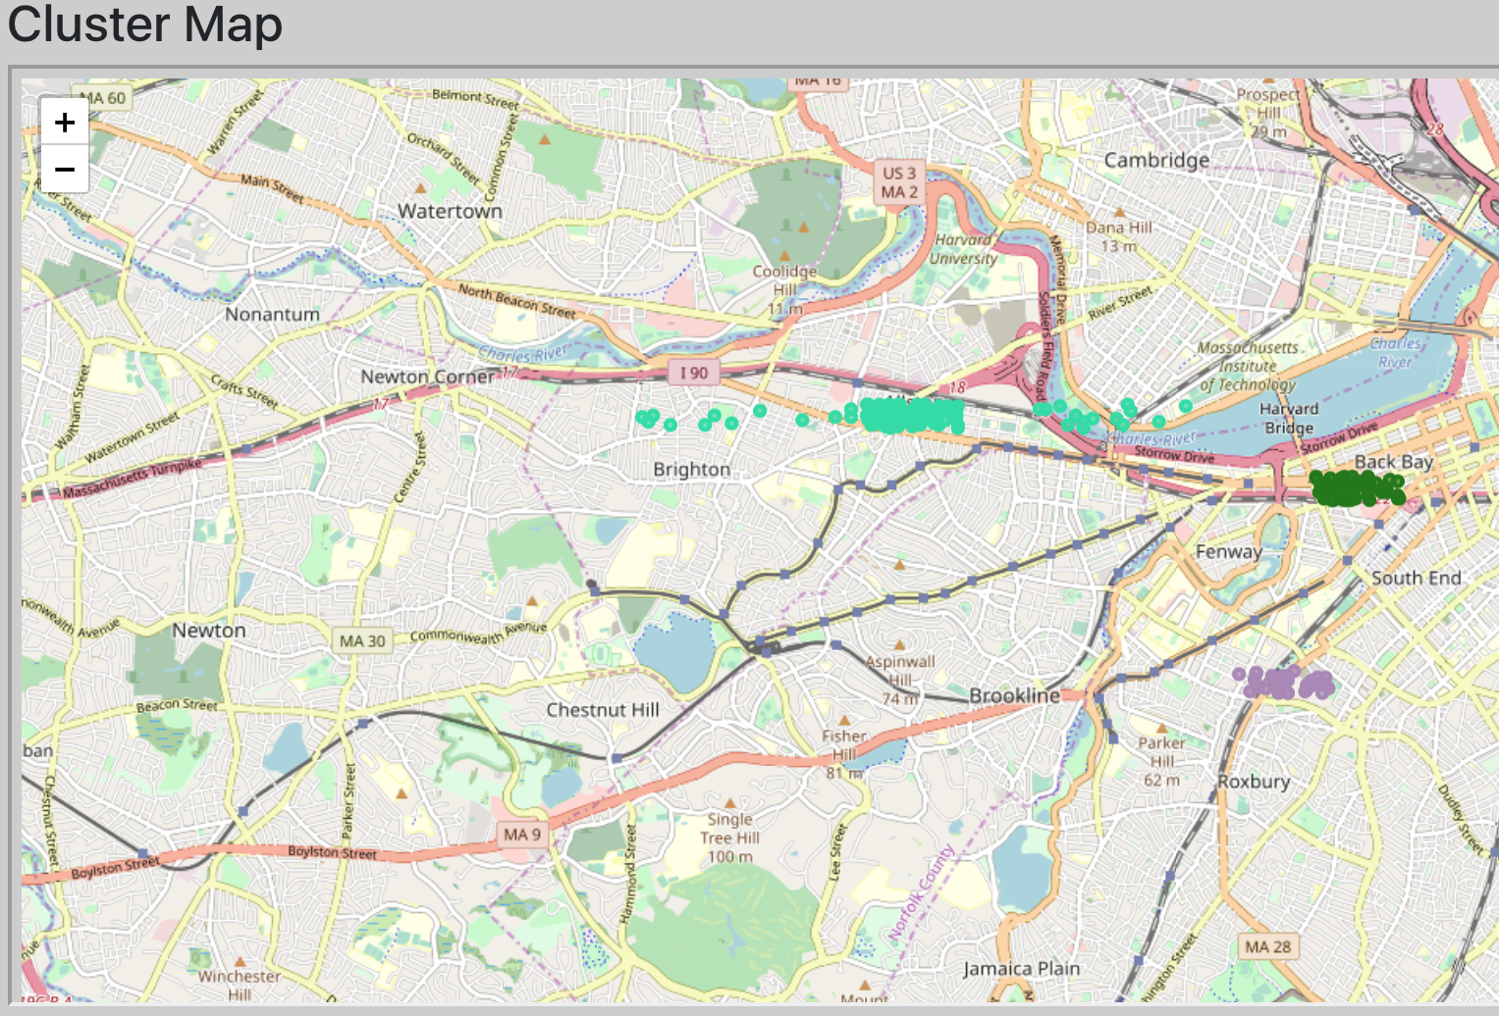
Try it out at hotspotter.herokuapp.com
Notes:
This data can be visualized through an interactive dashboard that shows real-time neighborhood clustered hotspots of disease trends as well as vectors of disease movement that may be due to changing environments.

Slide 11

Grants
Mass Office of Health
Development of partnerships with EMS dispatchers, and EHR integration costs.
Notes:
To fund this project, we will apply for a grant from the Mass office of health and human services to support our administrative implementation of emergency department survey handling, the development of partnerships with EMS dispatchers, and EHR integration costs.

Slide 12
Solution Benefits
Data-Driven Interventions
Providing support by showcasing environmental health factors to common people.
Healthier Communities
Create strength by empowering people to be together.
Educate public
Educate public by helping them understand precautionary measures in certain situations
Cost Savings
Reduced ED Visits saves taxpayer dollars through MassHealth
Notes:
Ultimately, our solution will lead to data-driven interventions to reduce environmental determinants of health and save MassHealth a significant amount of money from reduced ED visits.
Growing population
Trends and Health
Lack of resources - allocation of resources
Risk of serious illness -
Poverty Expensive Healthcare
Outdoor air quality
Surface and ground water quality
Toxic substances and hazardous wastes
Homes and communities
Infrastructure and surveillance
Global environmental health

Slide 13
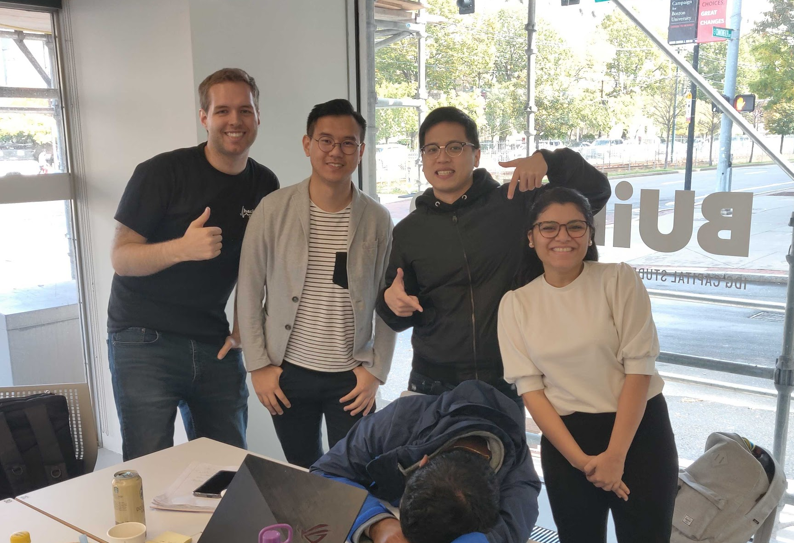
THANK YOU

Slide 14


